Slide 1
Review
Logic & Emotion

Slide 2
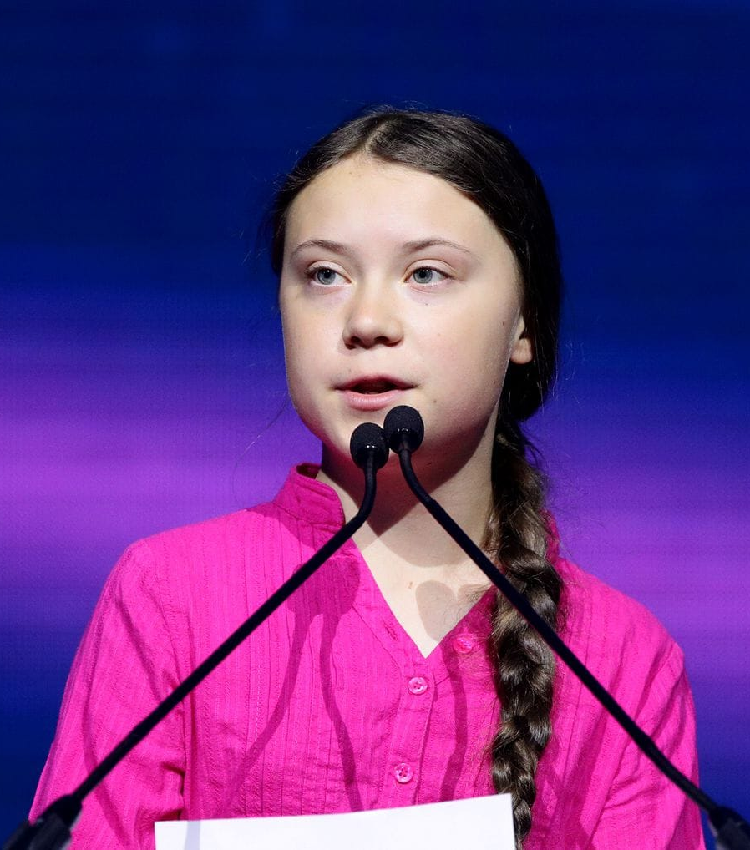
CONTEXT:
Greta Thunberg is a 16-year old student from Sweden who began school “strikes” to protest inaction regarding climate change. In September 2019, she spoke to Congress about this very issue.

Slide 3
❖ Where’s the logos (logic, reasons, facts, stats)?  Why is she bringing it up?
Some of you may have heard that we have 12 years as from 1 January 2018 to cut our emissions of carbon dioxide in half. But I guess that hardly any of you have heard that there is a 50 per cent chance of staying below a 1.5 degree Celsius of global temperature rise above pre-industrial levels. Fifty per cent chance.

Slide 4
❖ Where is the pathos, the emotion?  What emotion is she appealing to?
So a 50 per cent chance – a statistical flip of a coin – will most definitely not be enough. That would be impossible to morally defend. Would anyone of you step onto a plane if you knew it had more than a 50 per cent chance of crashing? More to the point: would you put your children on that flight?

Slide 5
❖ Identify the logos (logic, reasons, facts, stats)  Identify the pathos (what feeling is she trying to bring about in the audience?
The USA is the biggest carbon polluter in history. It is also the world’s number one producer of oil. And yet, you are also the only nation in the world that has signalled your strong intention to leave the Paris Agreement. Because quote “it was a bad deal for the USA”.

